Slide 1
System Analysis and Project Management
Prepared By - Vesh Raj Joshi

Slide 2
Introduction to System Analysis and Design
A System is a way of thinking about organizations and their problems and set of techniques that helps in solving the problems.
The term system is derived from the Greek word “systema”, which means an organized relationship among functioning units or components.
“A system is an orderly grouping of interdependent components linked together according to a plan to achieve a specific objectives.”

Slide 3
Introduction to System Analysis and Design
Characteristics of a system
Organization
Interaction
Interdependent
Integration
Central Objectives

Slide 4
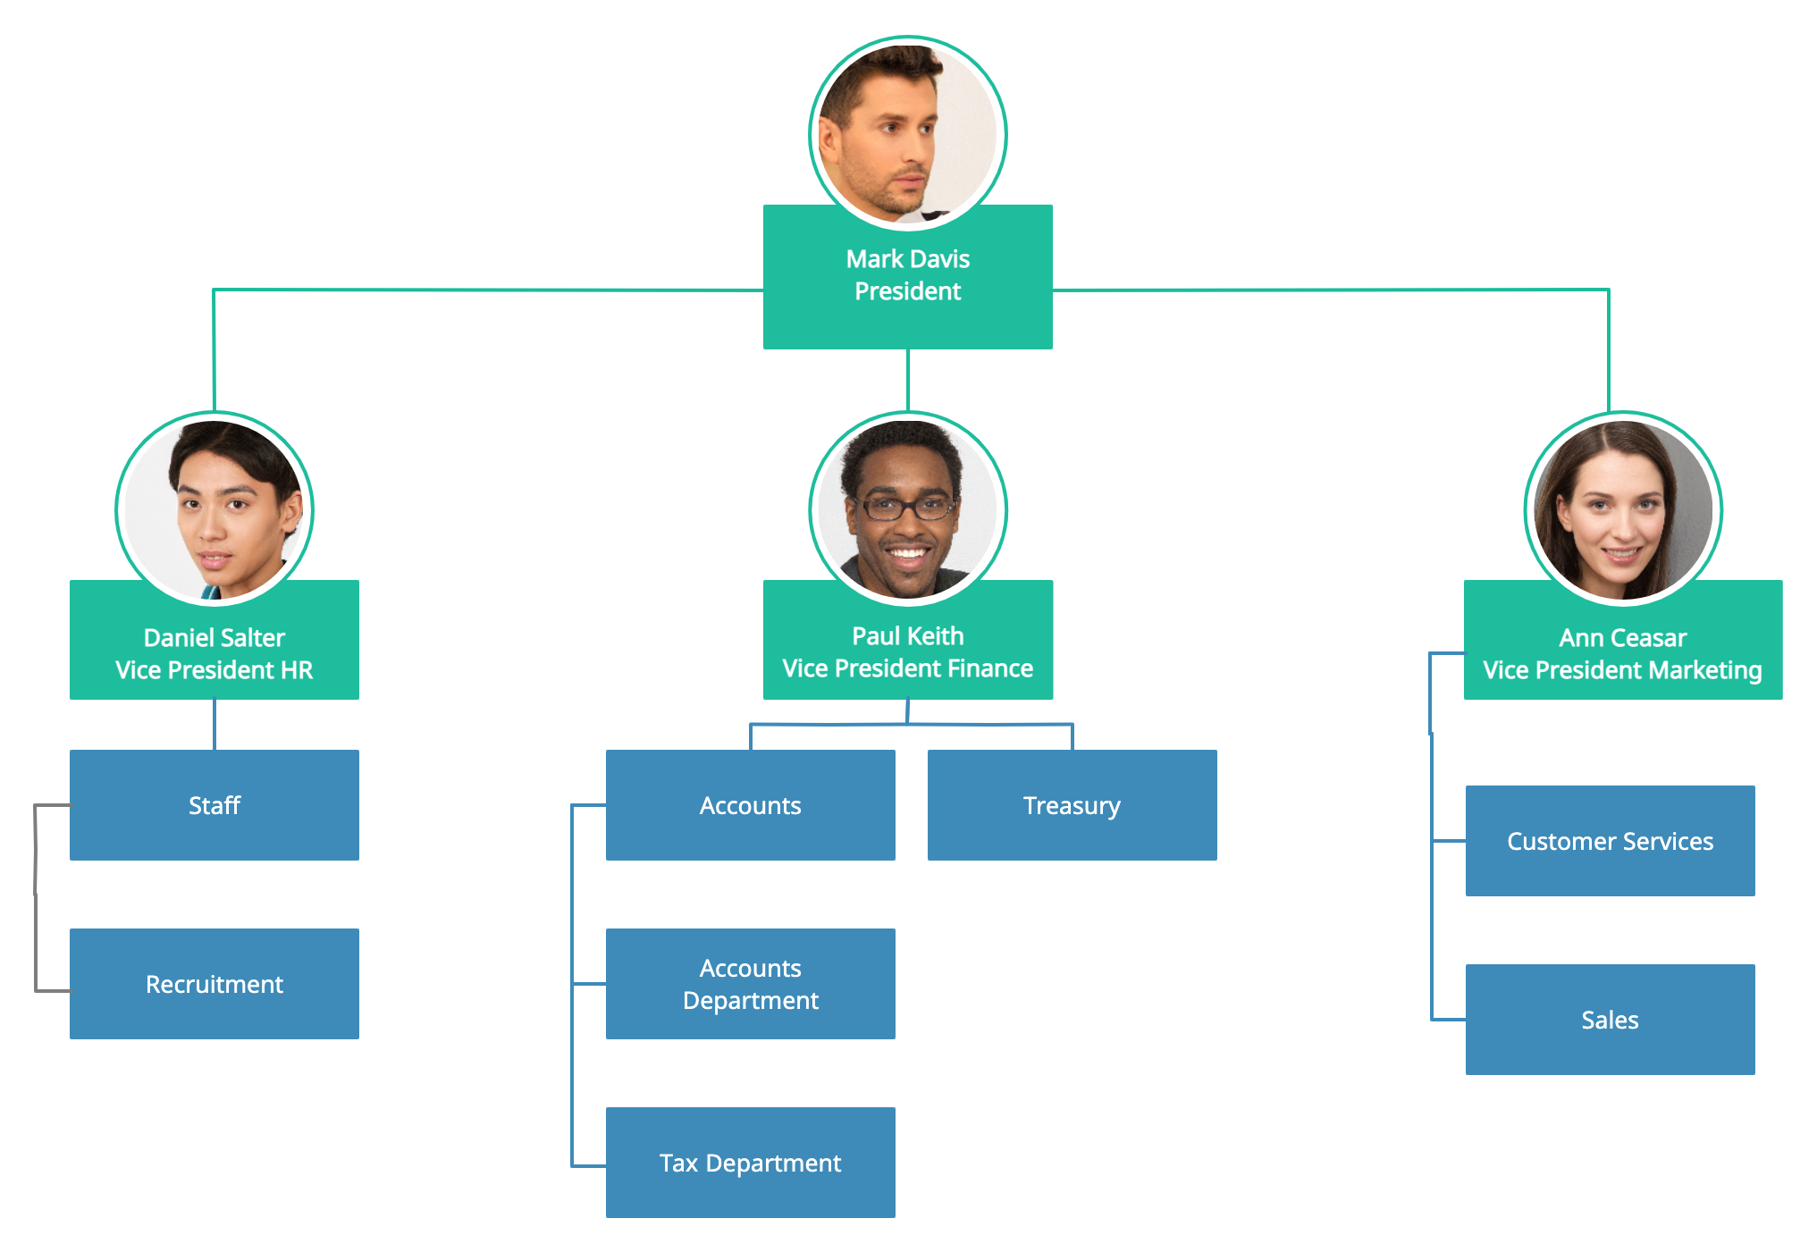
Introduction to System Analysis and Design
Organization
Organization implies structure and order
It is the arrangement of components that helps to achieve objectives.
For example - In the business system, the hierachichal relationship starting withi president on the top and leading downward to the workier represent to organization structure

Slide 5
Introduction to System Analysis and Design
“Interaction refers to the manner in which each component component functions with the other components of system.”
(“Interaction refers to the manner in which each component of a system functions and communicates with other components of the system.” - bibhushrestha)
For example – In a computer system, the central processing unit must interact with input device to solve a problem
Payroll with personnel
Teacher must interact with students in order to make them understand
Purchasing must interact with production
Interaction
CPU
Input
Data
Information
Output
Interaction

Slide 6

Introduction to System Analysis and Design
Interdependent
Interdependent means that part or component of organization dependent on one another
They are coordinated and linked together according to plan
One sub system dependents on the input of other subsystem for proper functioning
The output of one subsystem is required input for another subsystem

Slide 7
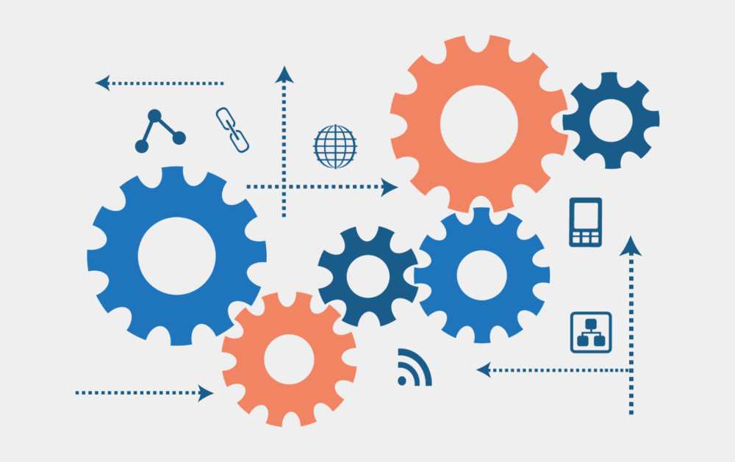
Introduction to System Analysis and Design
Integration
Integration refers to the holism of systems.
Integration is concerned with how a system components are coordinated and linked together within the system even if each part performs a unique function.

Slide 8

Introduction to System Analysis and Design
Central Objective
Objective may be real or stated.
All the components work together to achieve the particular objective.
The important point is that user must know the central objective of a computer application early in the analysis for a successful design and conversion.

Slide 9
Introduction to System Analysis and Design
Elements of a system
Input and output
Processor
Control
Boundaries and interface
Environment
Feedback

Slide 10
Introduction to System Analysis and Design
Input and output
Inputs and the elements (such as material, human resources, information) that refers for processing
Output is the outcome of processing
The main aim of the system is to produce an output with is useful for its user.

Slide 11
Introduction to System Analysis and Design
Processor
Is the component of a system that actually transform input into output. It is the operational component of a system.
Process may modify the input totally or partially depending on the specifications of the output. Modification must be able to regenerate input information if required.

Slide 12
Introduction to System Analysis and Design
Control
Guides the system to perform any particular task.
It is the decision making subsystem that control the pattern of activates governing input, processing and output.

Slide 13
Introduction to System Analysis and Design
Boundaries and interface
Boundaries are the limits that identify its components, processes and relationship when it interface with another system.
Each system has boundaries that determine its sphere of influence and control.

Slide 14
Introduction to System Analysis and Design
Environment
Environment is the source of external elements that affects the system.
It determines how a system must function.
For example-
Vendors and competitors of organization’s environment, may provide constraints that affect the actual performance of the business.

Slide 15
Introduction to System Analysis and Design
Feedback
Feedback provides that control in a dynamic system. It indicates how well system is performing. It is helpful for modify the system according to that need.
It provides to system how you make your system effective than other in the basis of computer choice.

Slide 16
Introduction to system analysis and design
What is information? Information is data that has been transformed into output that is valuable to users or system.
What is information system? “An information system (IS) can be defined technically as a set of interrelated components that collect, process, store, and distribute information to support decision making and control in an organization.” The information system deals with data of organizations. The purpose of information system are to process input, maintain data, produce reports, handle on line transaction, generate reports and other output
What are information system components?
Hardware
Software
Data
Processes
People

Slide 17
Introduction to system analysis and design
Hardware consists of everything in the physical layer of the information system. For example hardware includes servers, workstations, networks, telecommunications equipment, fiber optic cables, mobile devices, scanners, digital capture devise and other technology based infrastructures.
Software refers to the program that control the hardware and produce the desired information on the result.
System Software manages the hardware components, which can include a single workstation or a global network with many thousands clients.
Application Software consists of programs that support day to day business functions and provide users with the information they require.
Data is the raw material that an information system transforms into useful information.
Processes describe the tasks and business functions that users, managers and IT staff members perform to achieve specific results.

Slide 18
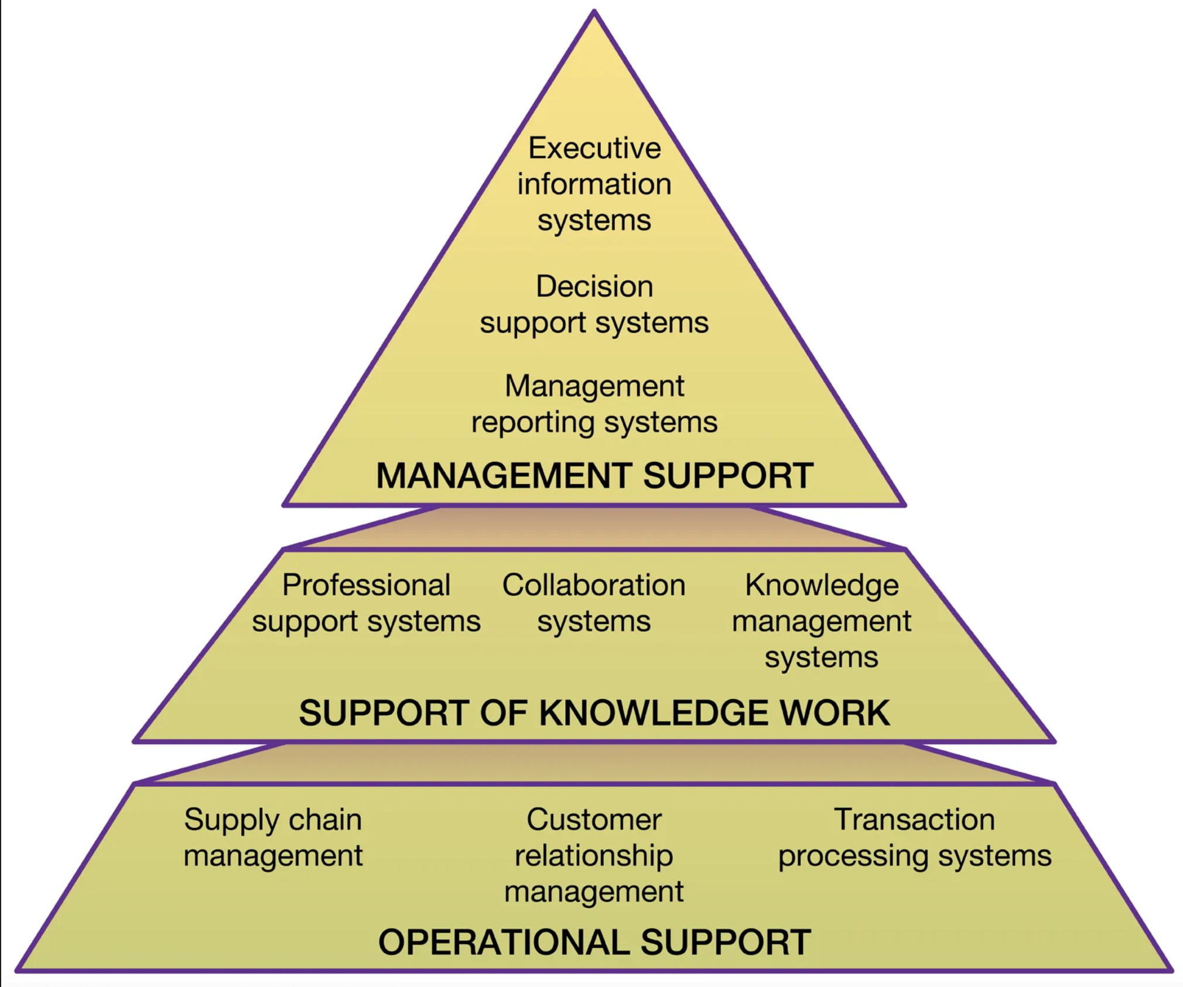
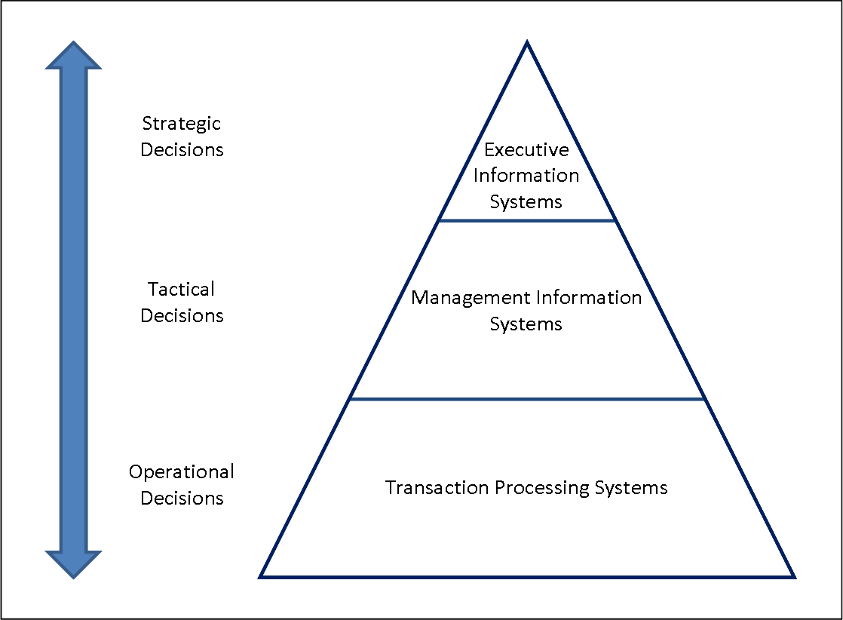
Introduction to system analysis and design
People who have an interest in an information system are called stakeholders.
Types of information System Information systems different in their business needs. It also depending upon different levels in organization information systems differ.
There are three major information systems:

Slide 19
Introduction to system analysis and design
Types of information system
ES
EIS
DSS
MIS
OAS
TPS
CCS

Slide 20
Introduction to system analysis and design
Transaction Processing System(TCP)
The TPS process business transaction such as order, payment, reservations, cancellation or transaction etc. Example POS(Point of Sale), School Billing System, Hotel Reservation System, OLTP(Online Transaction Processing) System.
Management Information System(MIS) – Stress on Efficiency – दक्षता, कार्यकुशलता
MIS uses the transactional data from the TPS to produce needed by managers to run the business. Helps to take for routing decisions. Example Report generation System, OLAP (Online Analytical Processing). Its implementation of strategy.
Decision Support System(DSS) – Stress on effectiveness / प्रभावकारिता
DSS helps the various decision methods to identify and choose the options and make appropriate decisions. In contrast, DSS contributes to achieving business objectives by offering sophisticated analytical tools and models that assists to in making informed decisions in complex, uncertain, or unstructured situations such as strategic planning, financial forecasting, optimizing operational processes, and. Exploring various “what if” Scenario. Its formulating the strategy.

Slide 21
Introduction to system analysis and design
Executive Information System(EIS)
EIS is defined as a system that helps the high-level executives to take policy decisions. This system uses high level data, analytical models and user friendly software for taking decisions. It is a structured, automated tracking system that operates continuously to keep everything managed. It provides exception and status reporting capabilities.
Consists of internal and external information system. It allows taking decisions to meet the strategic goals of the organization; and is in distributed nature.
Expert System(ES)
Expert System is designed to mimic the decision-making ability of a decision-maker. It organizes a set of knowledge about a particular subject. It contains facts and judgmental knowledge which gives it the ability to guess like a human. There are set of rules on which it makes decisions using ana if-else structure. The inference engine does reasoning by manipulating the knowledge base. The user interface represents questions and information to the operator and also receives answers from the operator. Knowledge Base, Knowledge acquisition and learning module, Inference Engine, User Interface, Explanation module

Slide 22
Introduction to system analysis and design
Communication and Collaboration System(CCS)
They enhance the communication and collaboration between people and business in an internal and external environments. Example Teamviewer, Whatsapp, Slack, Soon, Netbeam, Security Surveillance, Viber etc.
Office Automation System(OAS)
They help the employee of organization to create and share documentation that supports day to day operation. Example: office packages, Figma, Canva, Adobe Packages, Printing and copying services, Atlassian Package, Ticket System.

Slide 23
System Development Life Cycle(SDLC)
System Development life cycle concept
SDLC is a framework that describe that activities performed at each stage of a software develop project.
The business functions, each of these information systems has a particular purpose or focus and each has a life of its own – that’s why its called SDLC.
The development of new information system involves several different but related activities and phases like planning, analysis, design, implementation and maintenance support.

Slide 24
System Development Life Cycle(SDLC)
Phases of SDLC
1
Planning
2
Defining
3
Designing
4
Building
5
Testing
6
Deployment
7
Maintenance and Support

Slide 25

Software Development Life Cycle(SDLC)
Preliminary Study
Requirement understanding
Plan project approach, expenditures, risk analysis, technical analysis, financial analysis, resource analysis and etc.
Eagle view of project has been done regarding – cost, risks and technical analysis
Business analyst collect client’s requirements and make Business Requirement Specifications(BRS)

Slide 26

Software Development Life Cycle(SDLC)
Defining
Prepare SRS (Software) - all the requirements for the target software are specified.
These requirements get approval form customers, market analysts, and stakeholders
Defining
Functional Requirements
Functional Requirements
Requirement review & Approved

Slide 27

Software Development Life Cycle(SDLC)
Design – Arrangement of elements
Architectural Design The high level design that explains how the different parts of the system will interact
Database Desing Designing the database structure and relationships
User Interface Design Creating the interface through which the user interacts with the software

Slide 28
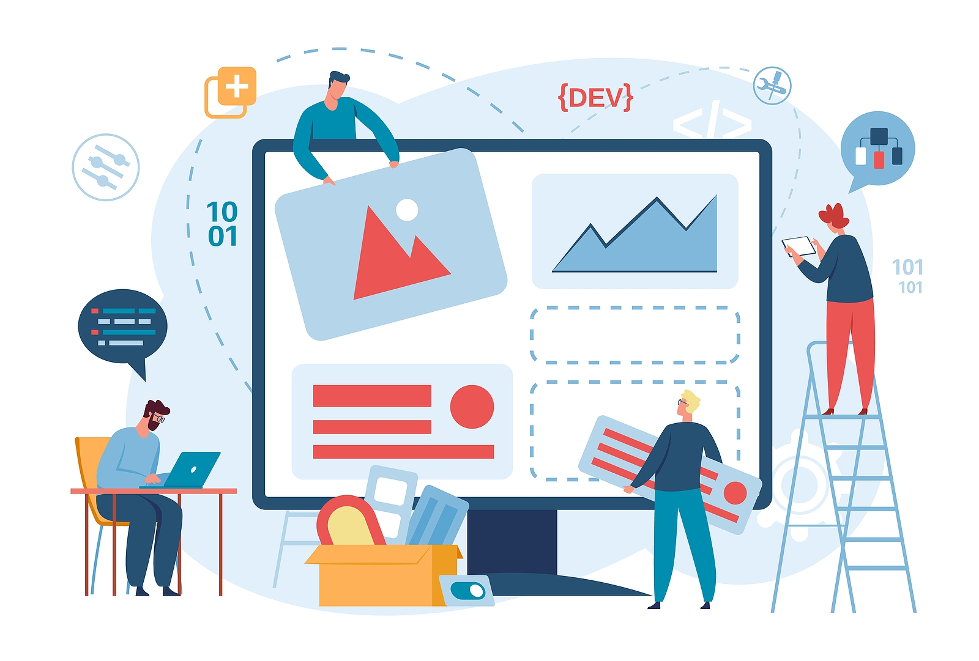
Software Development Life Cycle(SDLC)
Building
Coding Converting specification into digital format, web pages, server side script, APIs, Database migrations
Integration Integrating multiple components or features to make things happened in an organized way
Internal Testing Developer level testing and QA level testing in development and QA environments(Unit testing and integration testing).

Slide 29
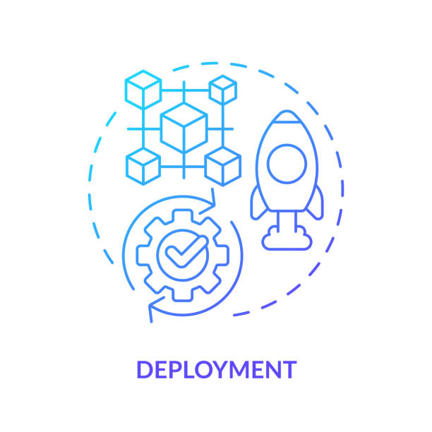
Software Development Life Cycle(SDLC)
Deployment/Implementation
System Testing Testing the complete and integrated system as a whole in production like environment.
User Acceptance Testing Evaluates if the system meets the acceptance criteria in Users perspective
Performance Testing if required This requires special knowledge and carried out only for critical software systems. This will ensure when will your system breakdown under which circumstances.

Slide 30
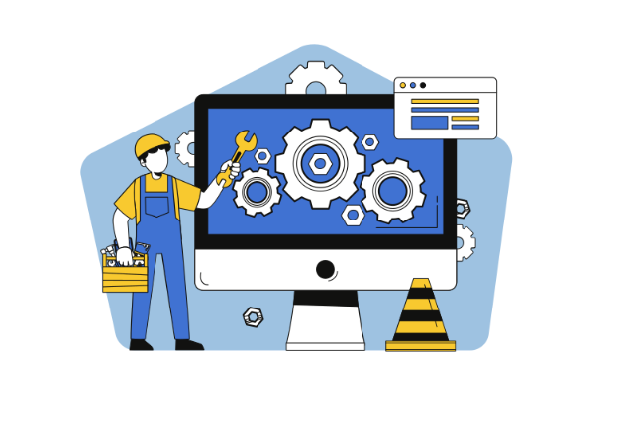
Software Development Life Cycle(SDLC)
Maintenance and support
Once the product is deployed in the market; client may want to add on supporting feature or provide some change request in existing features.
My be new bugs found while working; and technology upgrade is required.
Incorporate the correction as per the feedback from the end users.

Slide 31
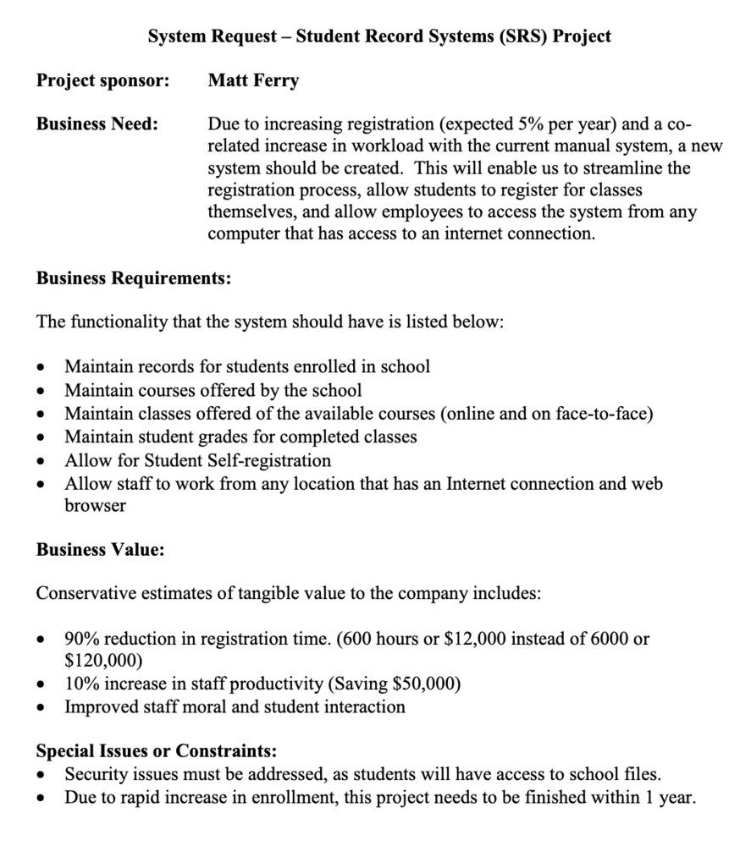
System Development Life Cycle(SDLC)
System Requests
A system request is a document or system used to initiate the systems development life cycle process.
It may be called something different in different organizations, such as a system proposal document or system initiation document.

Slide 32
System Development Life Cycle(SDLC)
What does a System Request include?
The project sponsor
The business need for the system (the business-related needs of the system).
The business requirements for the system (the requirements that the system must meet to be successful)
The business value of the system (how the system will pay for itself)Any special issues or constraints that may be relevant to the system
What to do?
Create a system request at the beginning of each project to make it clear for all stakeholders the main goals and results you want to achieve.

Slide 33

Software Development Life Cycle(SDLC)
Feasibility Study
Feasibility analysis is a process used to determine the viability of a particular project.
What does feasibility analysis include?
Technical feasibility
Economic feasibility
Organizational feasibility
Legal Feasibility
Why is it important?
The feasibility analysis process is important because it helps to identify potential challenges and issues before a project is fully committed to, allowing for informed decision-making about whether to move forward with the project.

Slide 34
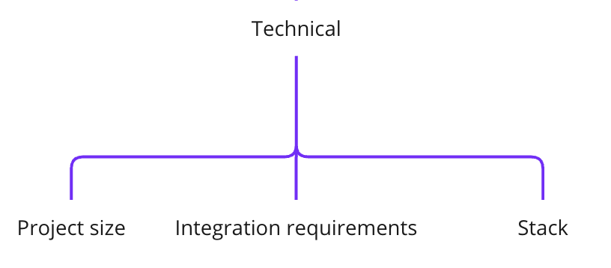
Software Development Life Cycle(SDLC)
1. Technical Feasibility
Technical feasibility is the evaluation of whether a proposed information system can be implemented with the available technology and within the organization's technical capabilities.
Some considerations for technical feasibility include:
Familiarity with the business application: Does the organization have experience using the type of system being proposed?
Familiarity with the technology: Does the organization have the necessary skills and tools to develop and maintain the system?
Project size: Is the project realistic in terms of the time and resources required to complete it?
Integration requirements: Will the system need to be integrated with other systems or processes within the organization? If so, is the organization capable of handling these integration requirements?
What to do?
Research all using services and integration across the organization to be prepared for its limitations.

Slide 35
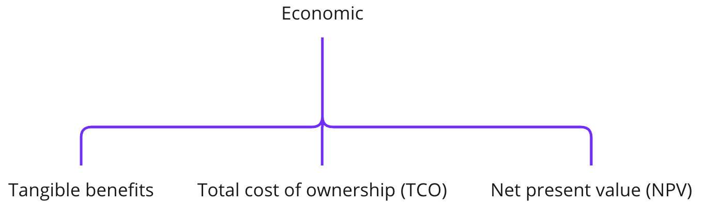
Software Development Life Cycle(SDLC)
2. Economic Feasibility
Economic feasibility is the second dimension of a typical feasibility analysis, and it answers the question of "should we build it?" In other words, is it a good idea from a financial or economic standpoint?
Some considerations for economic feasibility include:
Tangible benefits are the financial benefits that can be directly quantified and measured. These might include increased revenue, cost savings, or increased efficiency. Intangible benefits are the non-financial benefits that cannot be directly quantified, but are still important to consider. These might include increased customer satisfaction, improved employee morale, or increased market share.
Total cost of ownership (TCO) is the long-term financial cost of a project, including both the initial cost of development and the ongoing maintenance and support costs. It is important to consider TCO in economic feasibility analysis because it gives a more complete picture of the financial impact of a project.
Net present value (NPV) is another tool that can be used to determine economic feasibility. It is a financial calculation that estimates the value of a project by comparing the present value of the cash inflows (benefits) to the present value of the cash outflows (costs). A positive NPV indicates that the project is expected to generate more value than it will cost, while a negative NPV indicates the opposite.
What to do?
Try to count current costs of using all needed services and cost of operations with current volumes and predict possible scaling of the product in near future.

Slide 36
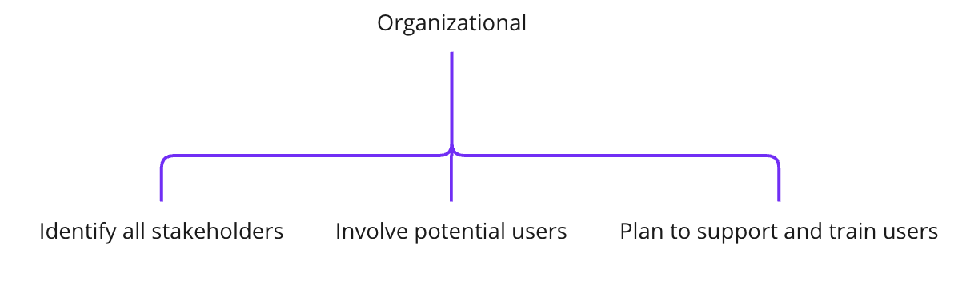
Software Development Life Cycle(SDLC)
3. Organizational Feasibility
Organizational feasibility is a dimension of feasibility analysis that assesses whether or not an organization is ready for a new or improved system or process.
Some considerations for economic feasibility include:
Leveraging stakeholders, including the project champion, to promote the project and its benefits
Building a coalition of supporters
Addressing any potential objections or concerns
Communicating effectively with all stakeholders throughout the project, including keeping them informed of progress and addressing any issues that may arise
Involving users in the design and testing of the system to increase their acceptance of the system and ensure that it meets their needs
Having a plan in place for training and supporting users after the system is implemented

Slide 37
Software Development Life Cycle(SDLC)
What does organizational feasibility involves?
It involves considering whether there is support for the change from both top management and users, and identifying any groups that may resist the new system
It involves whether customers are ready to use it by means of knowledge base or financial basis or features wise.
Why is it important?
By considering organizational feasibility and taking steps to address any potential issues, the chances of a successful implementation can be increased.
What to do?
Gather feedback from users after implementation and be ready to create user guides, teach employees and improve UI/UX design after first usage of the system.

Slide 38
Software Development Life Cycle(SDLC)
4. Legal Feasibility
Legal feasibility analysis evaluates the legal aspects of the proposal and how it will impact the existing operations. It scrutinizes legal dimensions to assess the viability and challenges associated with implementing the proposed venture.
Some consideration of feasibility analysis are:
Regulatory Compliance: You examine local laws, regulations, and industry standards that are relevant to the proposed endeavor to ensure compliance. This involves understanding licensing requirements, permits, zoning laws, environmental regulations, and other legal obligations that may affect the endeavor or its outcome.
Contractual Considerations: You will assess existing contracts, agreements, and potential contractual relationships to identify any legal constraints or obligations that may affect the proposed venture. This includes scrutinizing lease agreements, supplier contracts, distribution agreements, and any other relevant legal documents.
Intellectual Property Rights: You will evaluate intellectual property (IP) considerations (e.g., trademarks, patents, copyrights, and trade secrets) to safeguard proprietary assets and avoid infringement issues.
Liability and Risk Assessment: You will identify legal risks and liabilities associated with the proposal (e.g., product liability, tort claims, and contractual disputes).

Slide 39
Information System Stakeholders
Stakeholders Stakeholder is any person who has an interest in an existing or proposed information system. Stakeholders can be technical or nontechnical workers. They may also include both internal and external workers.
System owners
System users
System designers
System builders(Programmers/Project Managers)
Systems analysts
System Owner
An information system’s sponsor and executive advocate, usually responsible for funding the project of developing, operating, and maintaining the information system.
They usually come from the ranks of management.
medium (large) IS: middle (executive) managers
smaller IS: middle or supervisory
Primary Concerns
How much will the systems cost?
How much value or what benefits will the system return to the business?

Slide 40
Information System Stakeholders
System Users(End Users)
A “System User” who will use or is affected by an IS on a regular basis capturing, validating, entering, responding to, storing, and exchanging data and information
Make up the vast majority of the information workers in any IS – Primary concern: get the job done using an IS!
Internal users
Clerical and service workers, technical and professional staff, supervisors, middle managers, and executive managers
External users
Internet consumers, suppliers, partner
System Designers
A technical specialist who translates system users’ business requirements and constraints into technical solution. DBA, Solution architects, web designer, security expert.

Slide 41
Information System Stakeholders
System Builders(Programmers)
A technical specialist who constructs information systems and components based on the design specifications generated by the system designers.
Programmer is an IT professionals who use programming languages to create computer software, websites, and apps. Programmers are also known as software developers, or software engineers or coders. Coders use code to communicate with computers and tell them how to perform tasks. They write code to translate designs and concepts into functional programs.
Programmers' responsibilities include:
Writing programs in various computer languages to convert requirements into functional units.
Collaborating with customers, management, and departments to identify end-user requirements and specifications
Designing software architecture, Testing systems, Managing databases, Debugging code
Note: Coders often work in teams under time constraints, so they need to develop soft skills such as: Problem solving, Written and verbal communication, Time management, Teamwork, and Creativity.

Slide 42
Information System Stakeholders
System Builders Roles
Backend Developer
Frontend Developer(Mobile and Web)
Web Designer
QA
Team lead(Mostly Backend Developer)
Product Owner(Who knows product in best way most of the time non technical)
Scrum Master (Who facilitate meetings and protect team members from external factors that reduces productivity)
Graphics Designer
DevOps

Slide 43
Information System Stakeholders
System Analyst
A systems analyst is an individual who engages systems analysis and design techniques in solving a business problem. Systems analysts keep up to date with the latest technology to improve productivity at all times for an organization. They closely work with the sponsors and suggest what outputs are the best for business.
The primary purpose of systems analysis is to improve the efficiency, effectiveness, and functionality of a system. It helps organizations optimize their processes, make informed decisions, and achieve their goals.

Slide 44
Information System Stakeholders
System Analyst Skill set
Communication
A systems analyst works with a lot of people in varying departments in an organization. They need good communication skills to delegate roles and communicate problems that they identify.
Critical thinking
Systems analysts go through a lot of analytical tasks. They need good critical thinking abilities in order to help them in problem analyses, system development, and implementation.
Business analytics
A systems analyst mostly uses information technology knowledge in solving business problems. The knowledge of business analysis is of huge importance to a systems analyst as it helps one attain competence in problem handling.
Technical analysis
A systems analyst ought to be good in the knowledge of certain technical areas like programming languages, information technology infrastructure, and database administration.
Management
A systems analyst works with several individuals of different departments in an organization. They need good managerial skills for effective resource, including human resource, management.

Slide 45
Information System Stakeholders
System Analyst Roles and Responsibilities
Defining user requirements
A systems analyst has the responsibility of observing users and their requirements from a system. This can be done through conversational interviews with the users and anticipating the new needs of users from already existing systems. This helps in identifying the requirements from new systems via examination of current systems and updating configurations for new systems.
Prioritizing requirements
Systems analysts use social and analytical skills in prioritizing system specifications. Most enterprise systems have a lot of requirements but these are frequently constrained due to a lack of resources.
Different users in an organization have different needs from a system, but a systems analyst helps to prioritize the user’s needs in accordance with the available resources. This helps to ensure that maximum productivity is obtained from a working system.

Slide 46
Information System Stakeholders
System Analyst Roles and Responsibilities
Problem analysis
Systems analysts tend to observe data and facts about an operating business. They use technological techniques in identifying problems and removing unnecessary details so as to enable the fulfillment of real needs from a system.
Drawing specifications
Systems analysts also assign the relevant responsibilities of managing system requirements to the right individuals and team members. They specify programming tasks to programmers and managerial tasks to managers. They also document these system tasks in detail, using specification documents, and review the output to ensure that it matches the required specification.
System design and evaluation
Systems analysts guide the development of every system in an organization, from the specification of requirements to the designing of the system itself. They ensure that the built systems correspond to the system specifications by carrying out system evaluation. They also test the performance of the built system to ensure that it meets the required performance as specified.

Slide 47
Information System Stakeholders
System Analyst Roles and Responsibilities
Keeping up to date with technological advancements
Systems analysts are real agents of change in the use of technology in an organization. They tend to observe the overall use of technology in an organization and work to keep up with evolving technological demands by replacing outdated technologies with the latest ones.
They frequently encounter the challenge of having the users accept the changes and, therefore, involve the users in the development process. They do this by conducting interviews with the systems’ users and identifying possible user needs and requirements in order to integrate the latest technology for users. From time to time, systems analysts check to make sure that an organization is working with the latest technological systems, thus giving rise to high productivity and output.

Slide 48
Hmmmm..
That’s end of Unit I
Thank you

